Slide 1
Digital solution

Slide 2
Introduction
This project is to make a map for ASAS with different topic such as meeting point, exit. Besides, I hope it can bring more convenience to all students in ASAS, guiding them or giving the instruction which wont mislead and the students will remember.
It is mainly for the new students or some visitors who don’t have well-known of the school.

Slide 3
User Story
The target audience are everyone in the school especially the new students of the school
It will show the direction to go to the safe place while the fire emergency, it can benefit the new student to know where should they go during the fire emergency

Slide 4
Constraints
Time : the technical proposal has used three weeks to finish, I have enough time to do research or to finish it
Sources: google map, google map API and python
It can be access by the Google Map API key legally due to the copyrights

Slide 5
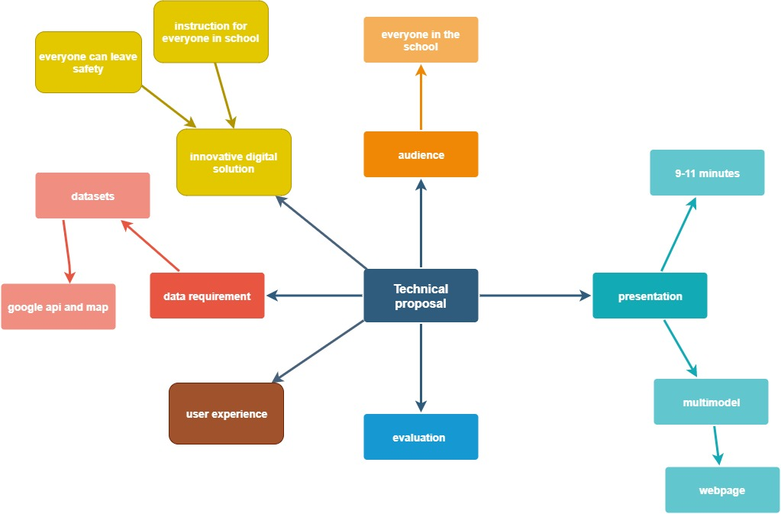
Breaking down the task (MINDMAP)

Slide 6
Success Criteria
Accuracy and the efficiency of the algorithms
Present user-interface prototype
Accuracy of data
Convenient for target groups and audience
Make the website be more user-friendly
Data can be upload to the database
Present the non-coded prototype digital solution

Slide 7
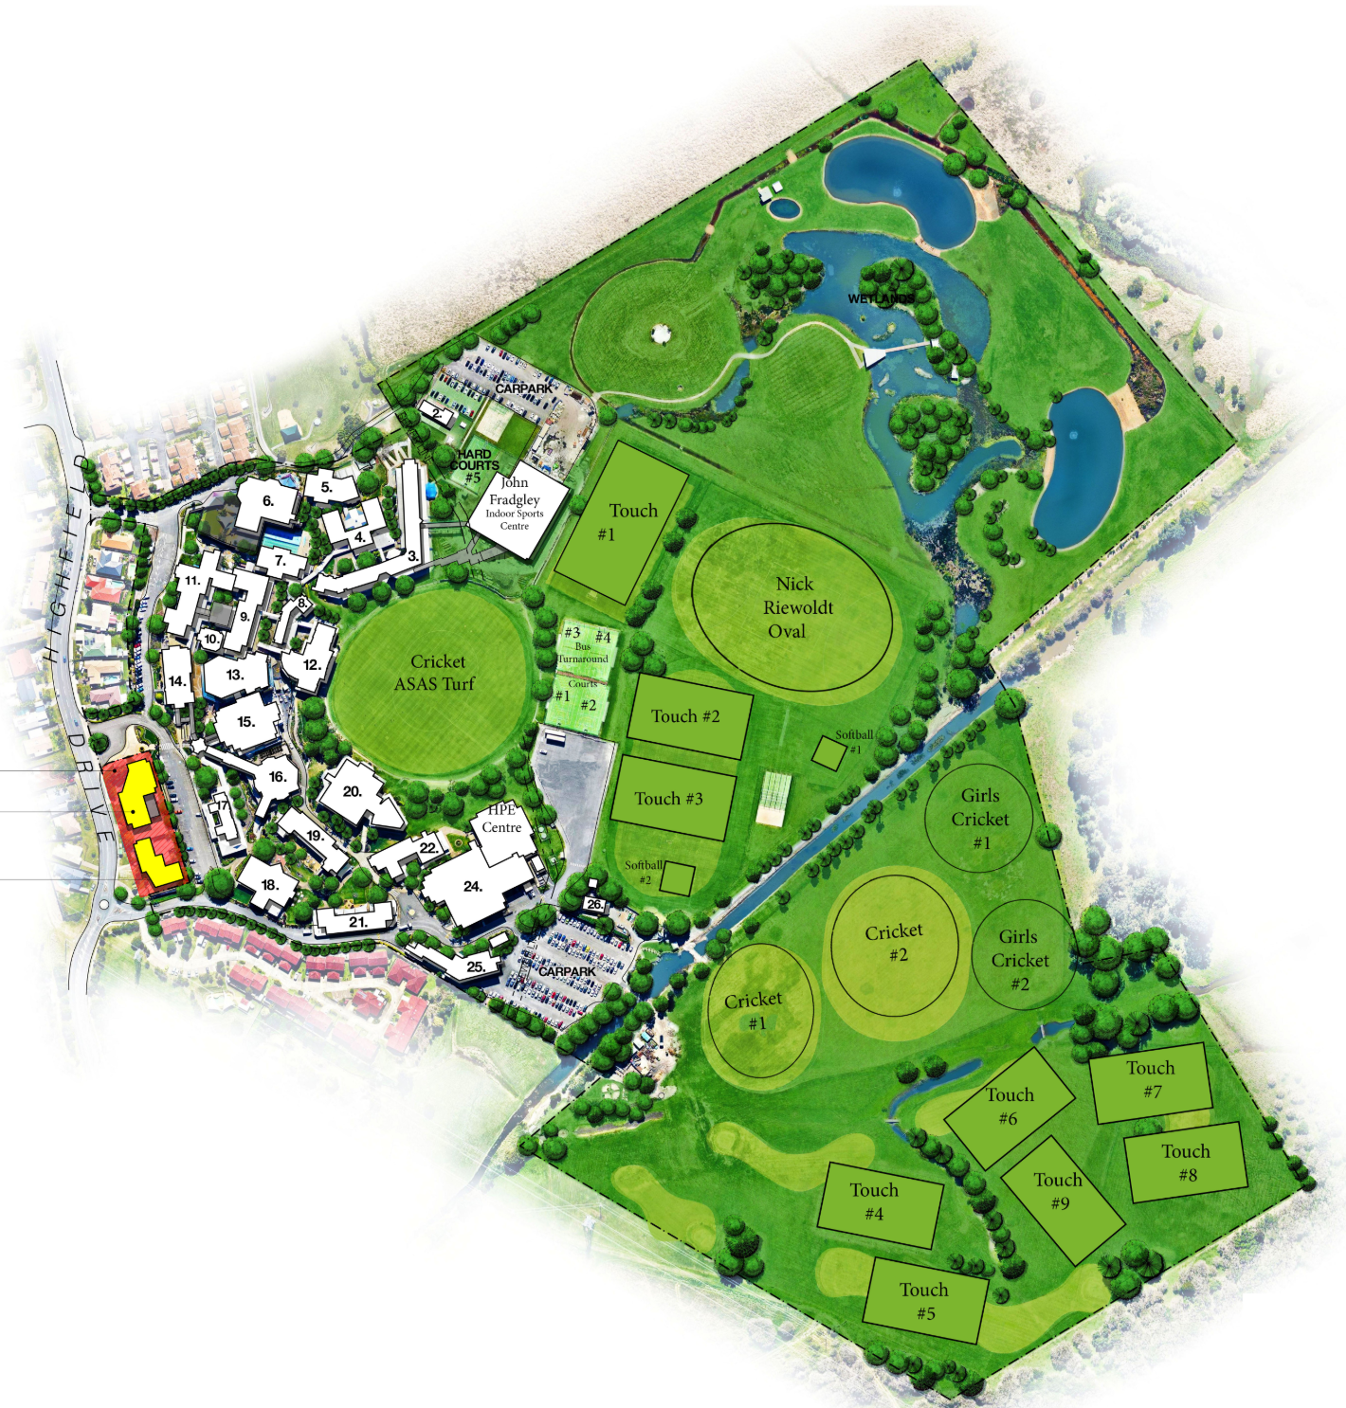
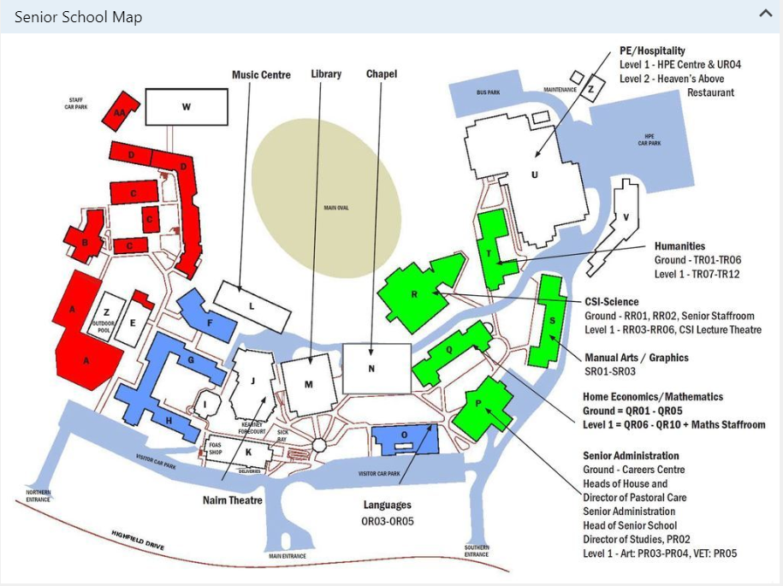
Existing Solution

Slide 8

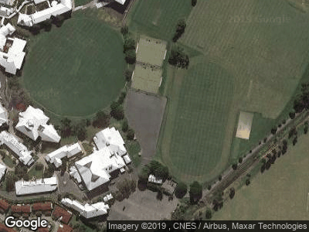
Dataset
You can move the pin and path by using the longitude and latitude in the google map
You can type the coordinate to the python code to change the direction of the path or the path fill as well as the pin.

Slide 9
Data Parameters
The Google Static Map web service dynamically creates a map image based on URL parameters (i.e. latitude, longitude, zoom level, image height & width, scale, map type) sent through a standard HTTP request and returns the map as an image you can display on your web page.

Slide 10
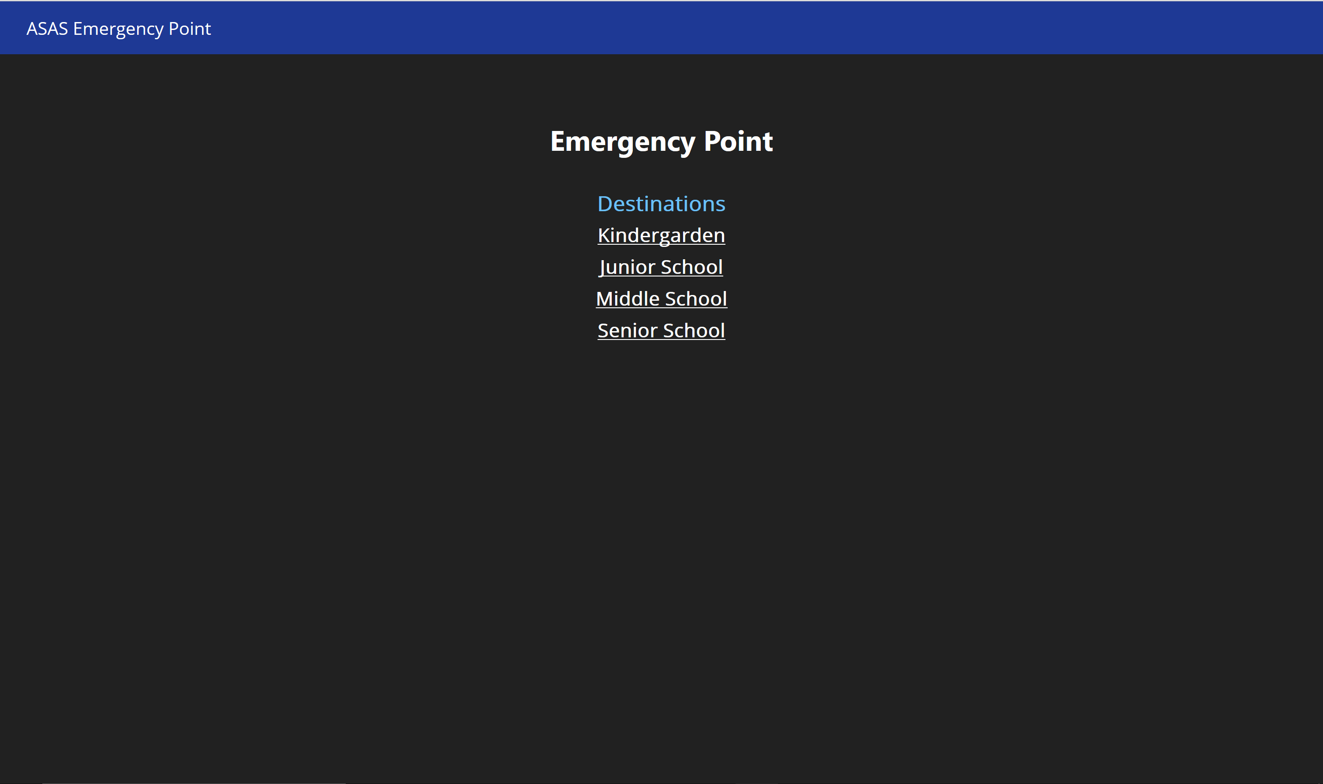
User interface

Slide 11
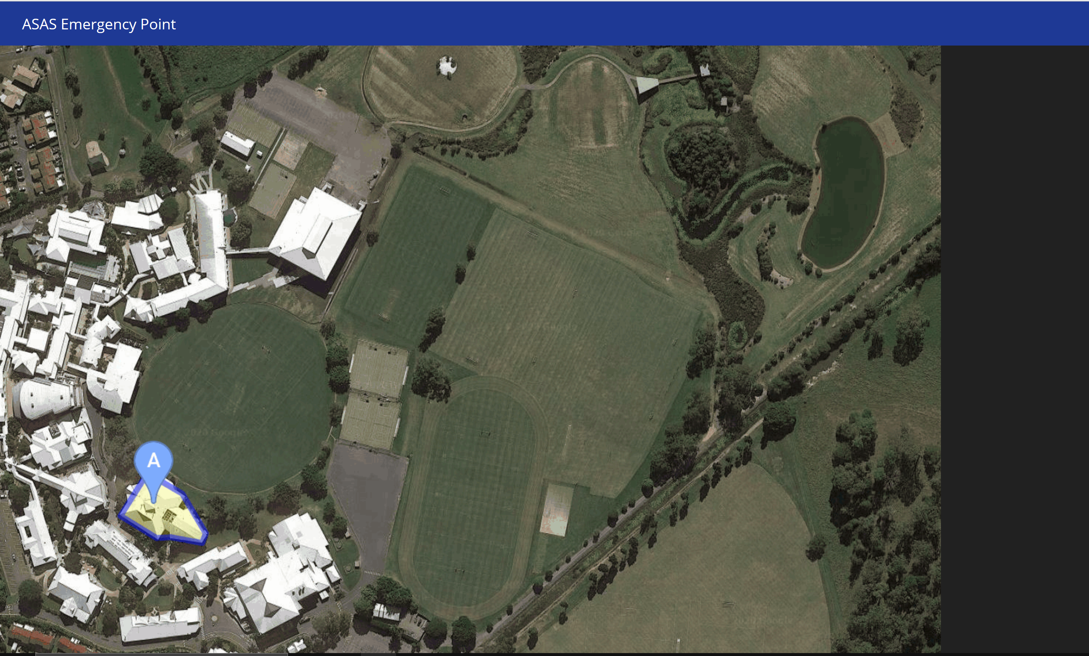
User interface

Slide 12
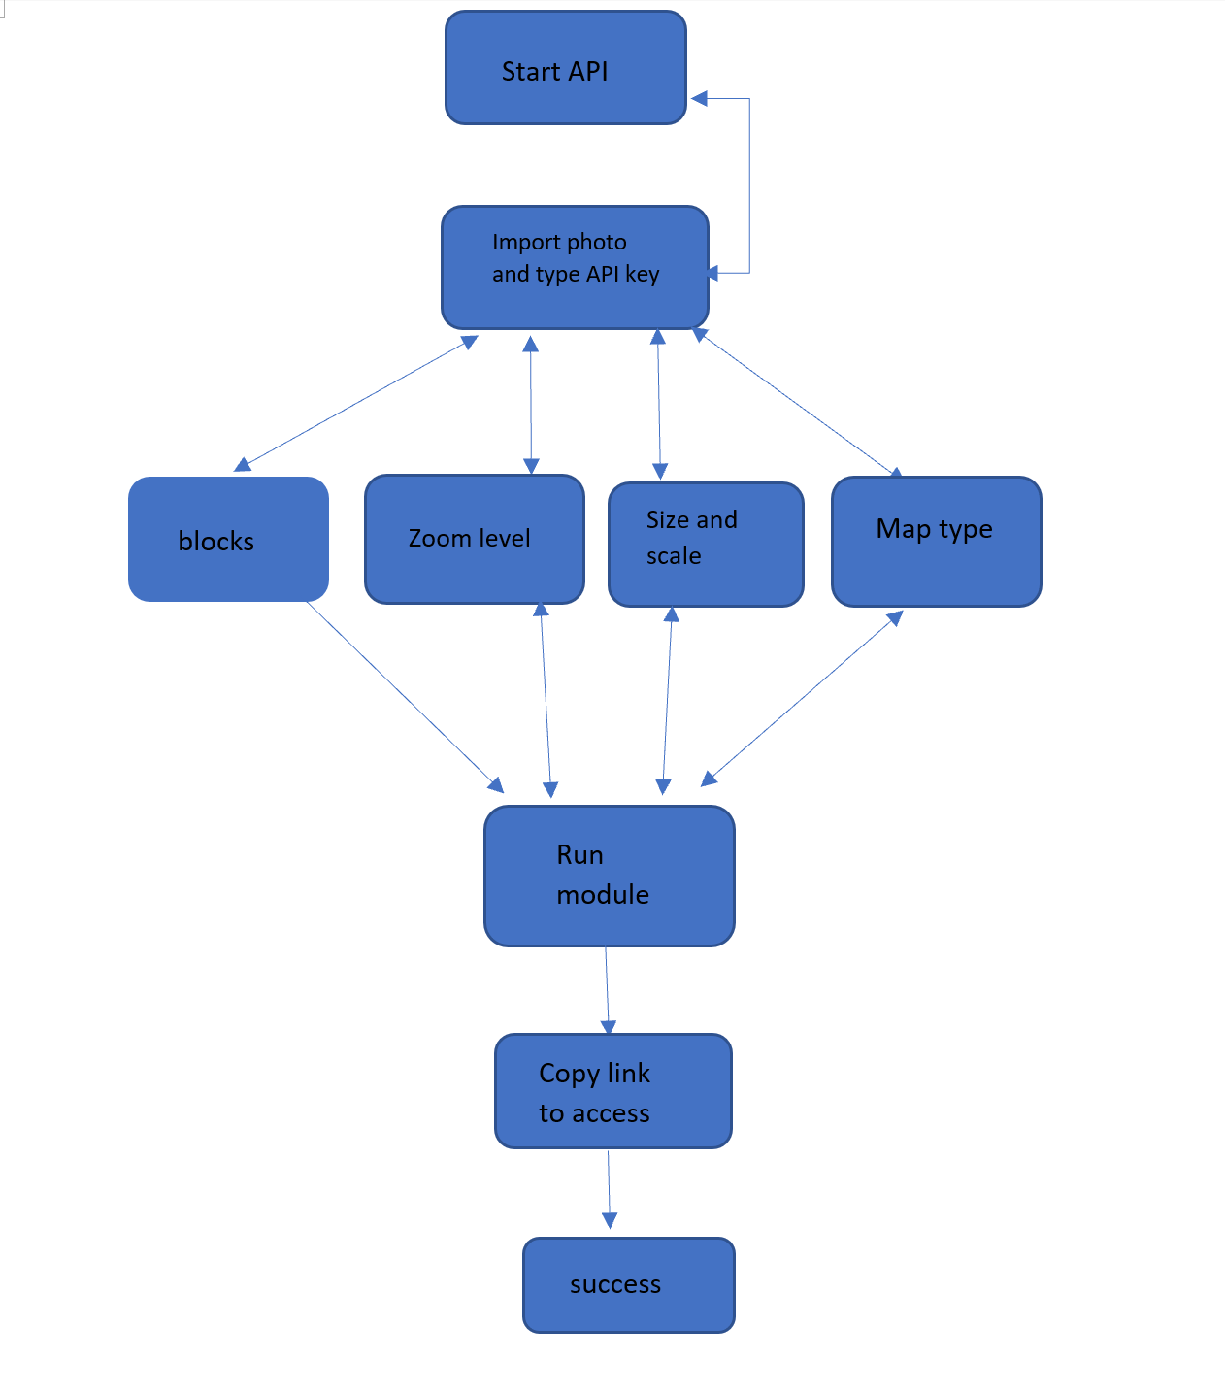
Algorithms
Open Googlestapicmap.apikey.py
Importing the photo in the script
Enter the API key
Type the URL of the ASAS map
Edit the blocks ( pin, path) with the coordinate in map
Edit the zoom level
Type the size and the scale
Change the map type to satellite
Run the module
Copy the link to access the map
Successful access

Slide 13
Conclusion
Prescribed criteria | Evaluation | Recommendations
Useful for the new comers or visitors and students | Webpage is useful for all students because everyone has the laptop to check out the website and the map. Users can open the website of school to access the map It doesn’t collect personal or store data, it is available for the whole school
User interface | It is easy to access the map and convenient the user, user do not need instruction to access the map because it is a simple design website Home page is clean and easy to follow due to essential items are all in the homepage | Opinion on different color scheme instead of single color or else it becomes lack of color. Resize the text or add more symbols . Should be used more images in the frontpage which will make the webpage more colorful and better for users.
Accuracy of algorithms | Algorithm has been run in the existing module and dataset and it is successfully to run and display the webpage
Non-coded prototype digital solution | The prototype works well because the user interface is mainly the prototype Easy to navigate, blue colors buttons which is the color of ASAS | Could be add more different color or change layout

Slide 14
Prescribed criteria | Evaluation | Recommendations
Accuracy of data | Accuracy of data is dependent to the google API key also the python codeGooglestapicmap.apikey.py The data have already edited to more user-friendly such as the scale size and the map type The data has followed the guideline instructions
Convenience of use for target audience | Font and the words are easily to read Students can easily to access to the webpage and the settings of the webpage is convenient for the users. Users will remember the webpage or keep in mind due to text are outstanding as well as the color
Make the website be more user-friendly | It is already user-friendly because it is easily to access

